Slide 1
How to Access and Enjoy
the Saville Library’s eBooks

Slide 2
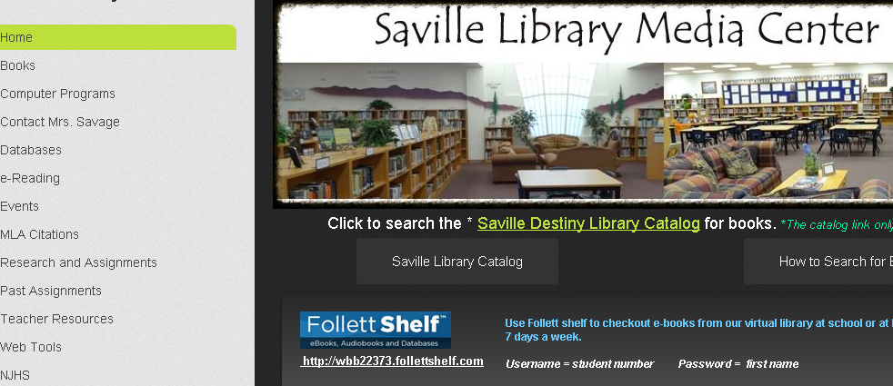
Step 1
Go to Mrs. Savage’s website
www.asavagelibrarian.yolasite.com

Slide 3
Step 2
Scroll down to the eBook Portal and click the Universal Search link.

Slide 4
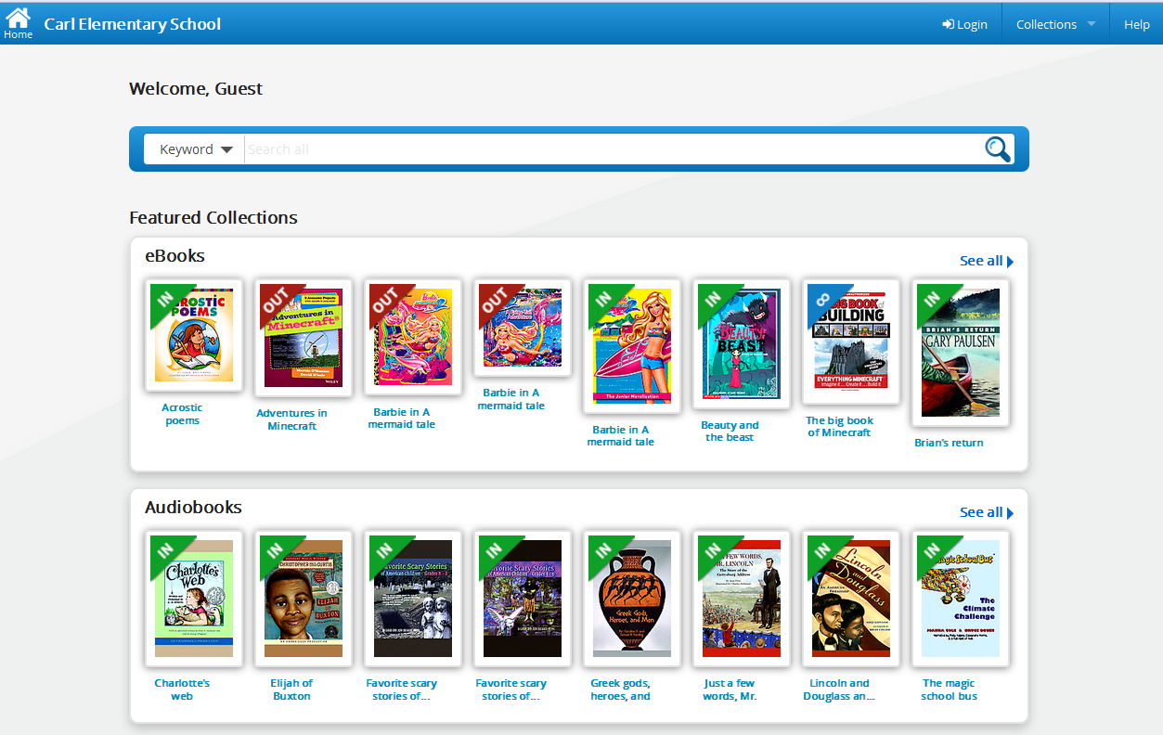
Step 3: Select Login

Slide 5
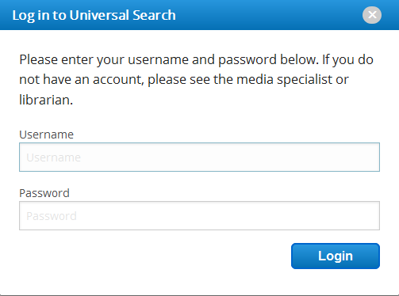
Step 4: Enter Your Info
Student Number
First Name
Click login (hitting enter won’t work)

Slide 6
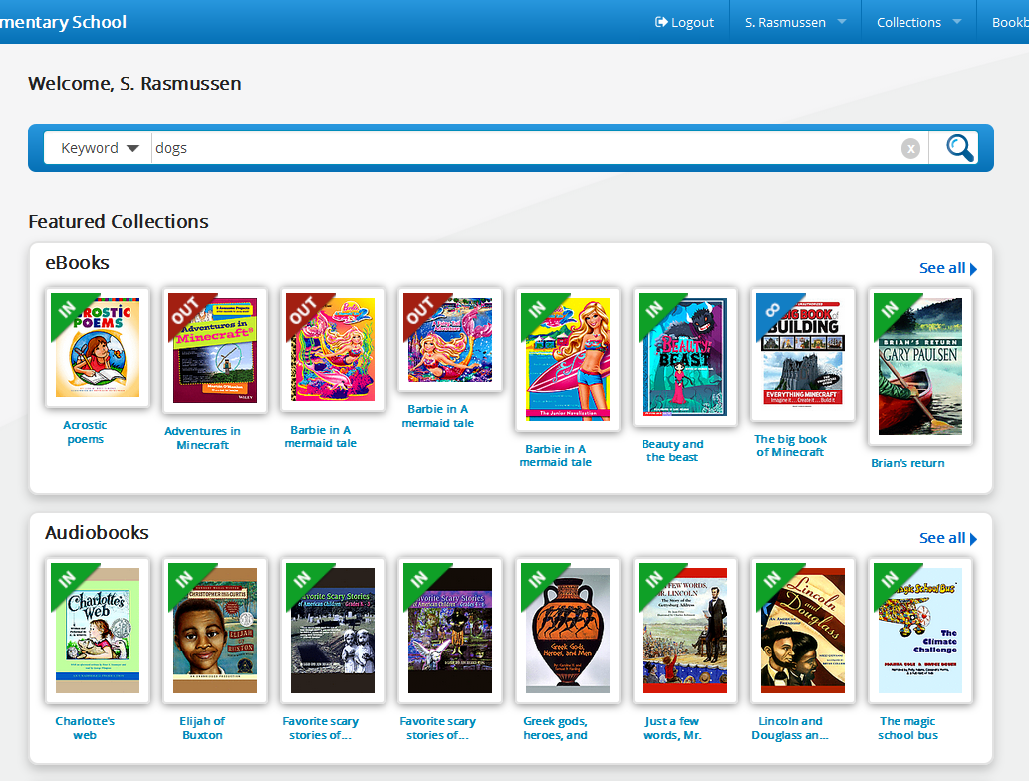

You’re In!
Search Here
. . . 0r browse for eBooks
. . . 0r browse for audiobooks

Slide 7
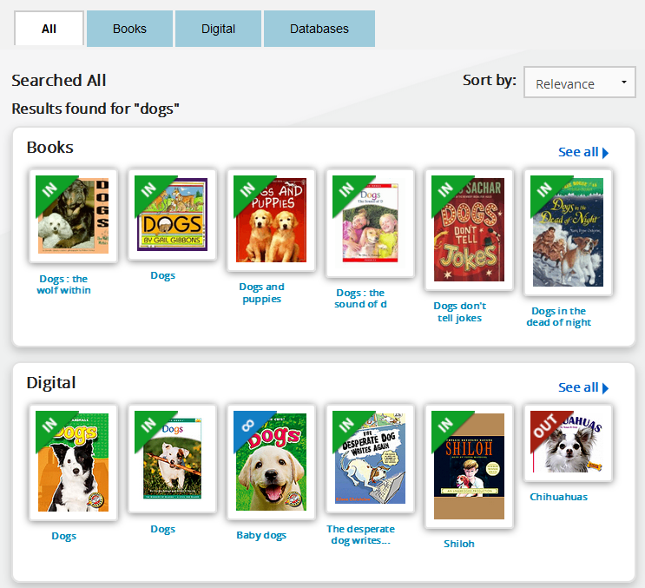


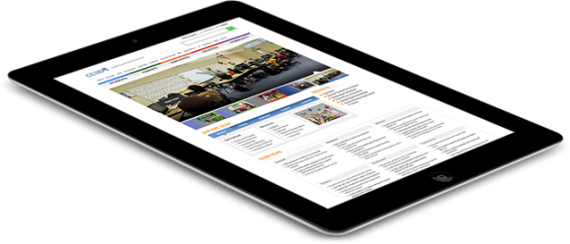
Search results show our library’s print books, eBooks and audiobooks.
‘Books’ are print library books
‘Digital’ items
are eBooks & audiobooks

Slide 8
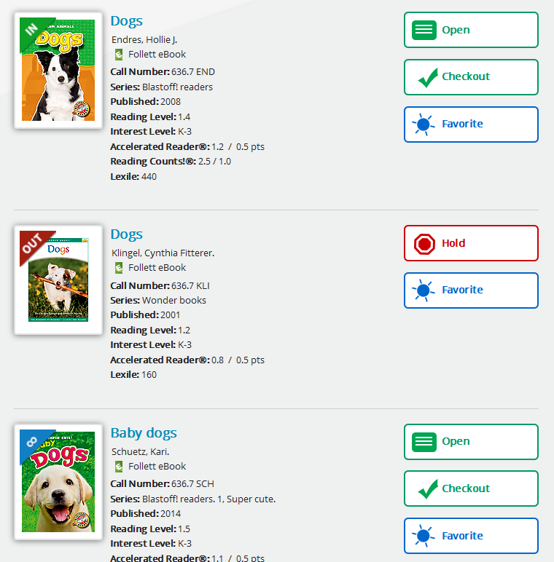
available
Sample Searches
dogs, sharks, Batman, ghosts, Percy Jackson, Star Wars, mystery, fantasy, horror
checked out
unlimited copies

Slide 9
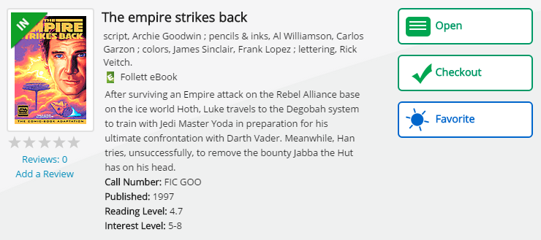
Open a book to preview it.
Borrow it right away.

Slide 10
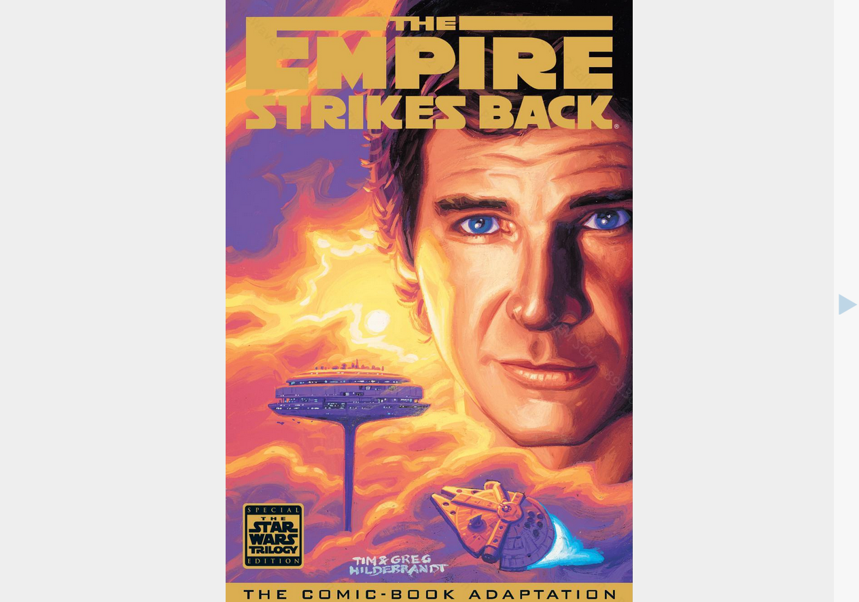

Once you open a book…
Click here to turn pages

Slide 11
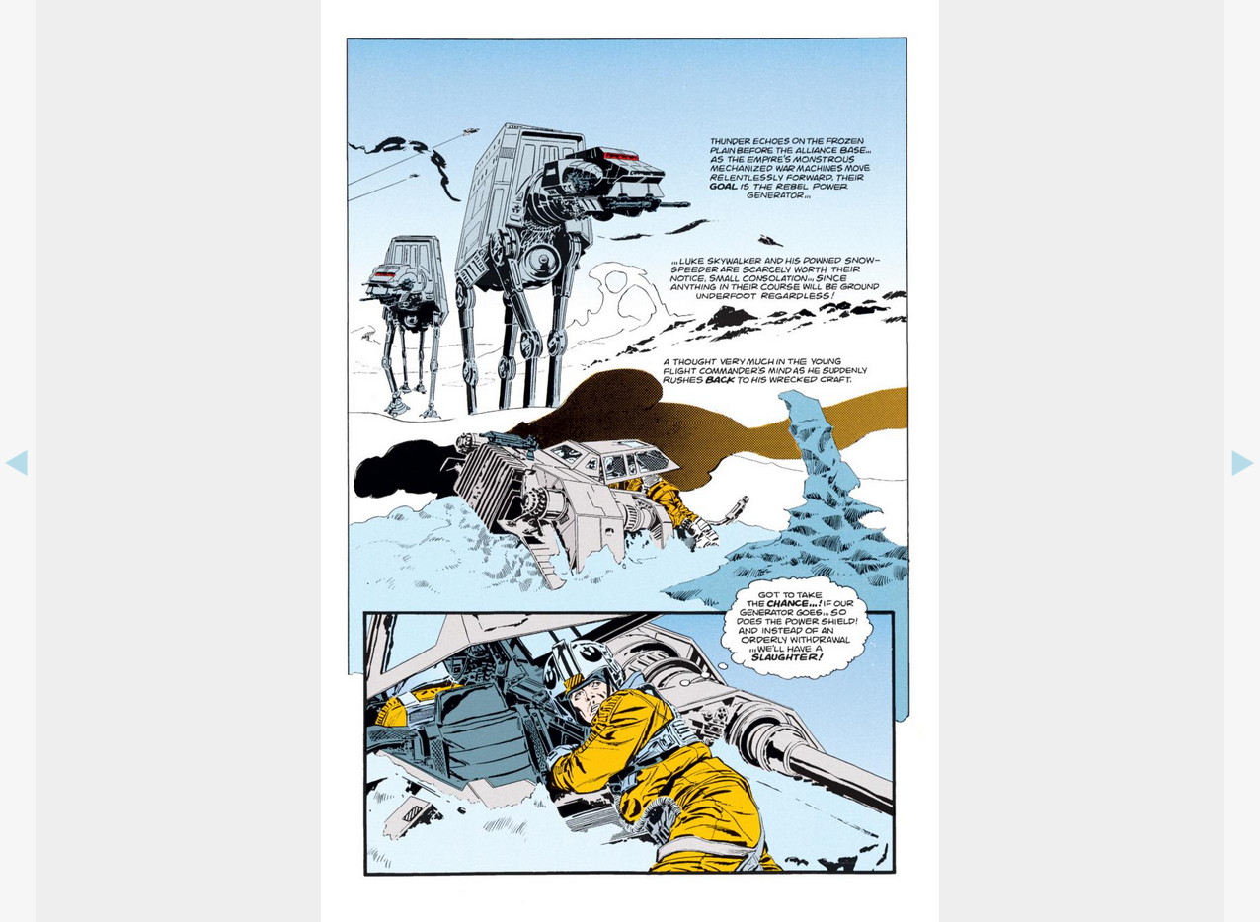
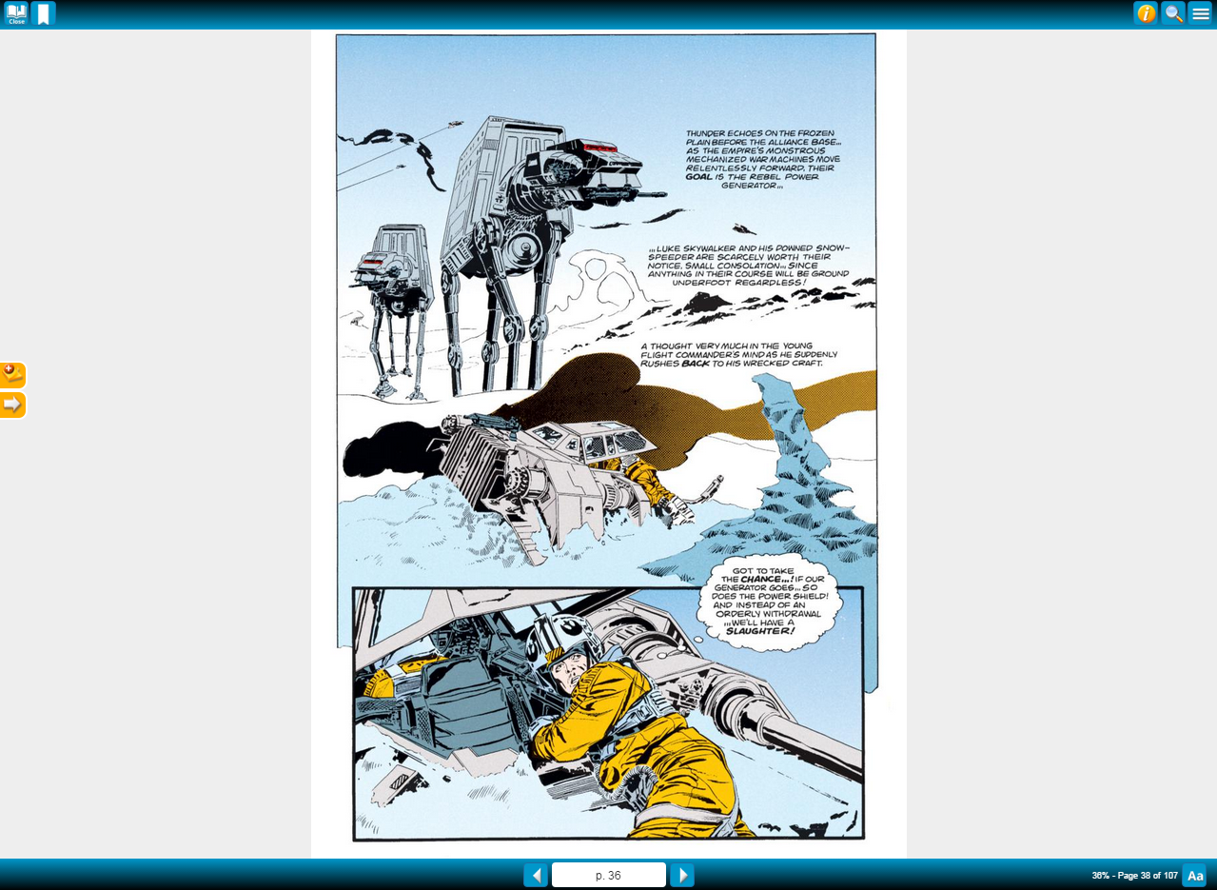
Click in the middle of the page to active the controls.

Slide 12
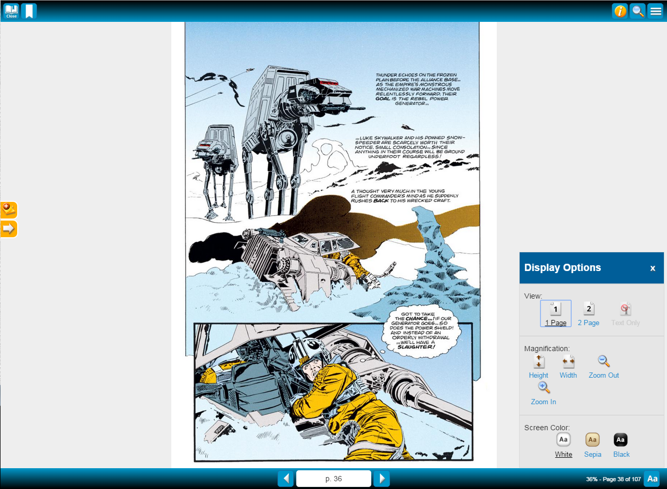
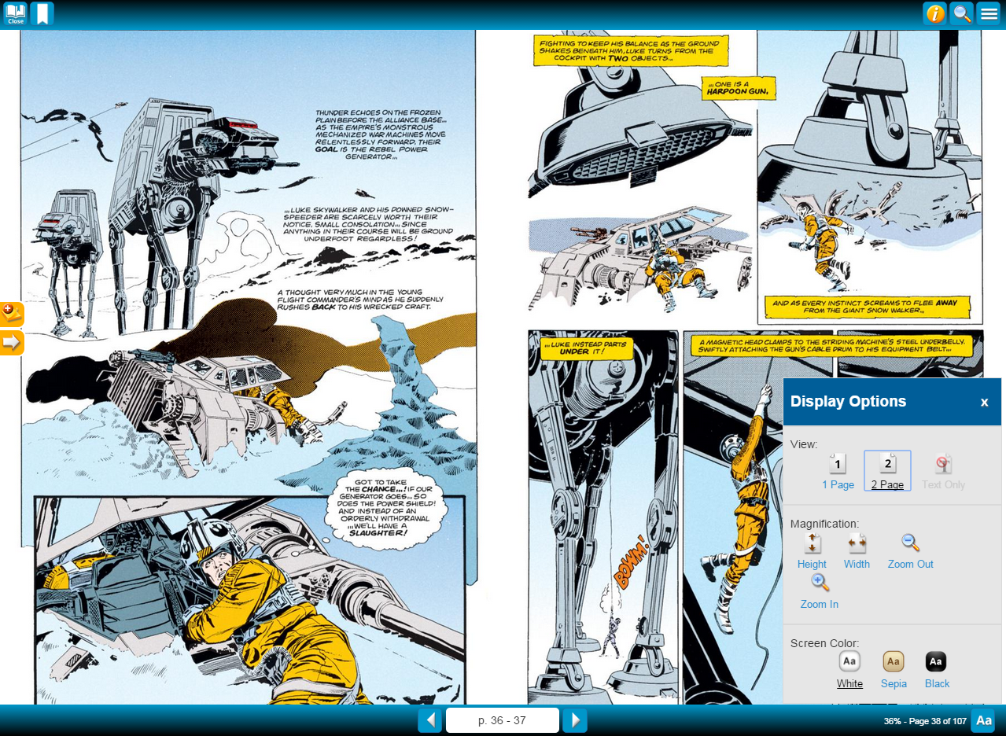
One Page View?
Or Two Page View?

Slide 13
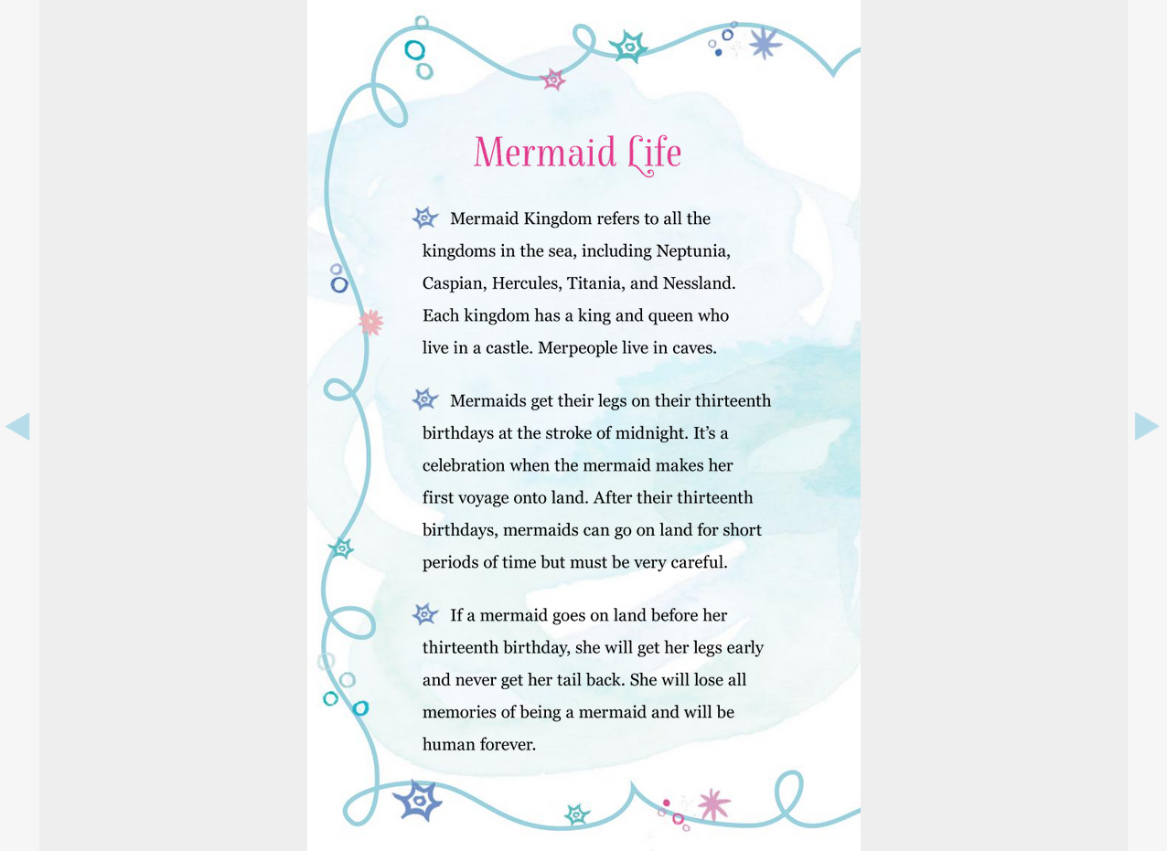
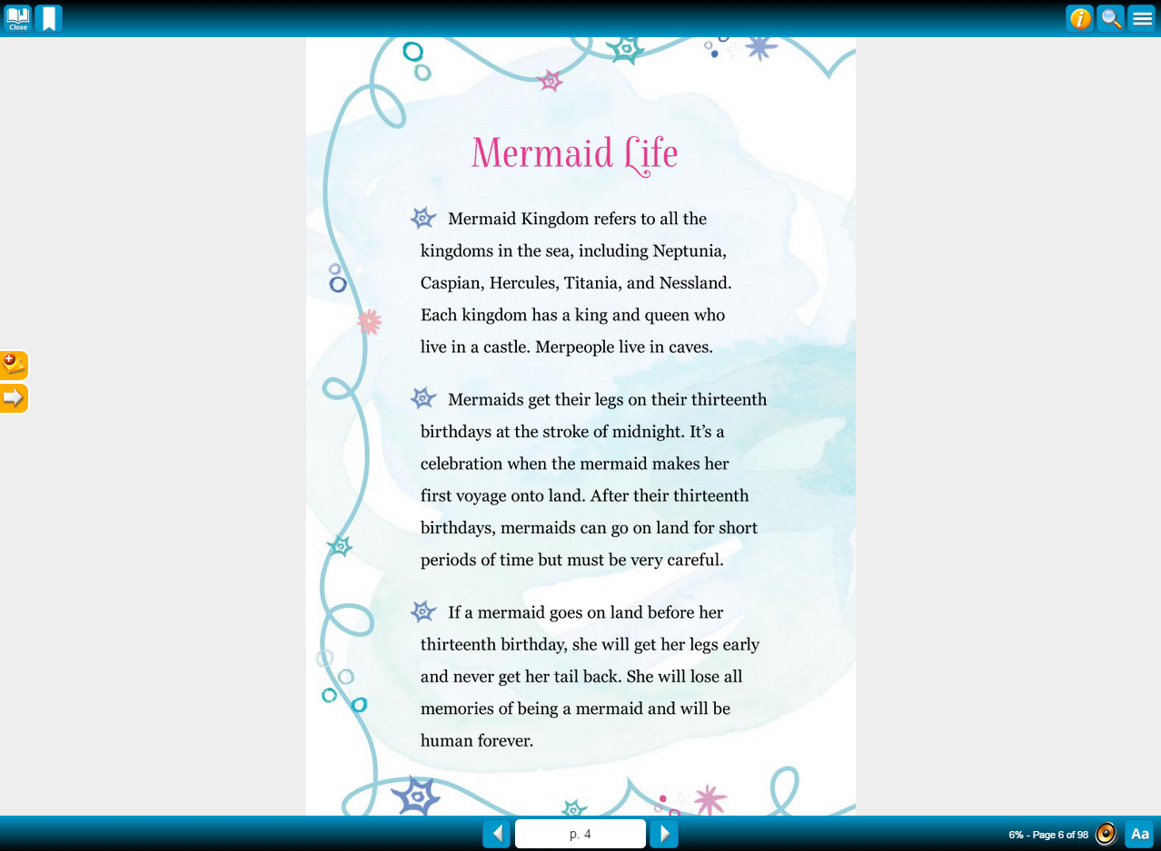
Some Books Will Read To You!
If the feature is available, click the speaker.

Slide 14
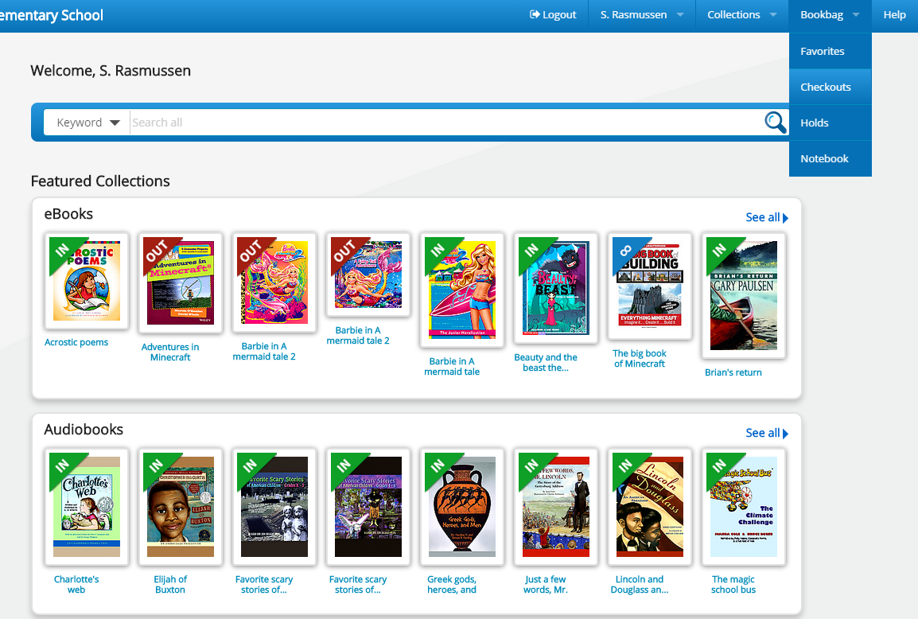
Bookbag
Go to Bookbag to
see what you have checked out.

Slide 15
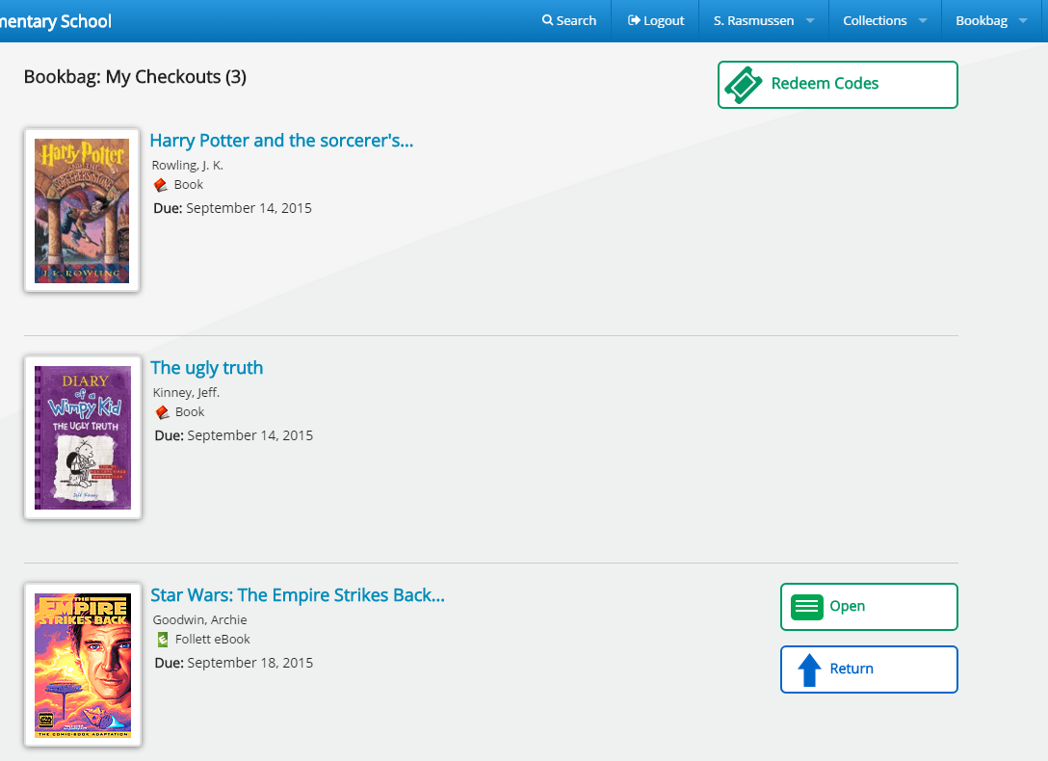
Bookbag
These are the print books that you have checked out of the library. Return them on library day.
Once in Bookbag, click Open to read the eBook on a computer, smart phone, tablet or E-reader.
This is an eBook. It will automatically return in seven days.

Slide 16
Bookbag
If you’re done with an eBook, return it early so that others can also enjoy it.

Slide 17

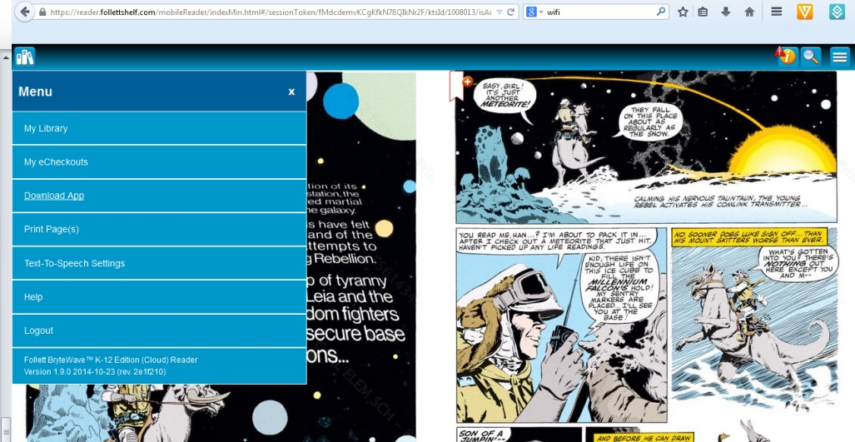
The BryteWave App
You can simply use Follett Shelf through a web browser, but if you’re going to read often, you’ll want to download and install the BryteWave K-12 Edition app. It offers additional features.
The free app can be found at the Apple Store or Google Play Store. For a master page of all BryteWave app sites, visit: https://reader.follettshelf.com/mobileReader/brytewavek12/apps.html
For activation, our shelf code is wbb22373.
links to all apps

Slide 18

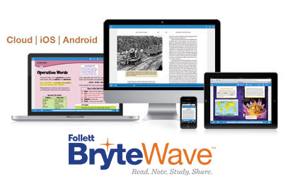

Benefits of eBooks
Our eBooks will read to you
Available 24 hours a day, 365 days a year
These are in addition to the two print books that students already borrow during library class
They cannot be lost, stolen, or damaged
Audiobooks let you listen to great stories
They can never be late
They’re free for you to use!

Slide 19
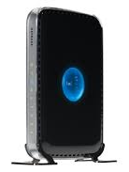
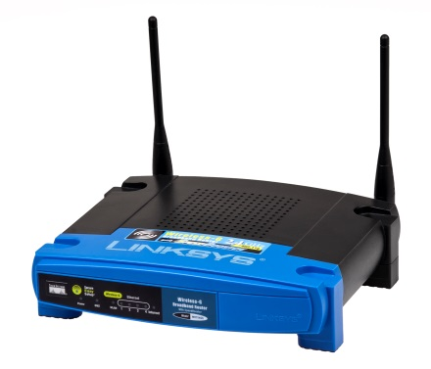
Connecting Your Device
Outside of School
You’ll need WiFi to at least initially connect your device. Through BryteWave, you will then be able to download your eBooks and read them at any time.
If you don’t currently have WiFi at home, these ISPs offer discounted Internet rates to CCSD families in need.
http://ccsd.net/district/mobile-device-initiatives/pdf/home-internet-access.pdf
As part of the Mobile Device Initiative (MDI), local businesses offer free WiFi hotspots to CCSD students. Visit the MDI web site for locations.
http://ccsd.net/district/mobile-device-initiatives

Slide 20


Connecting Your Device at School
Connect
to the school’s WiFi
0402-WiFi
password: faxhale9
manual/advanced server information:
proxy.ccsd.net
port 80
Login using the BryteWave app
Username: student #
Password: first name
Shelf url: wbb22373

Slide 21
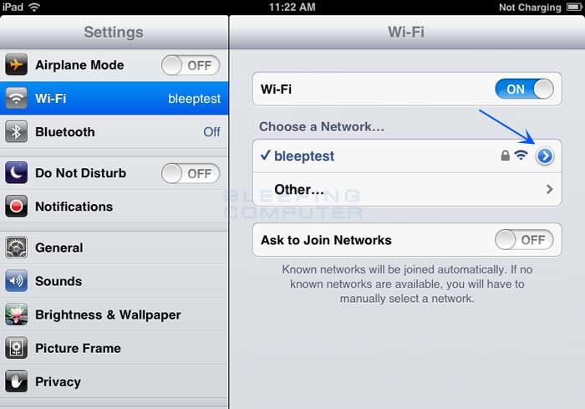
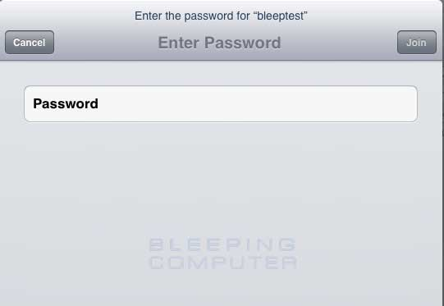
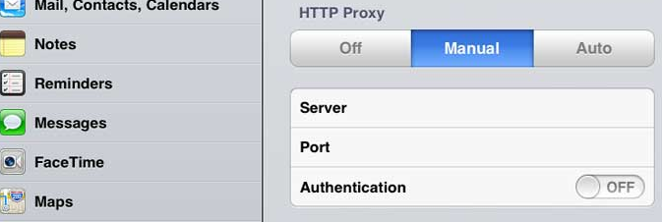
faxhale9
proxy.ccsd.net
port 80

Slide 22

Links
Is your device compatible?
http://www.aboutfollettebooks.com/techspecs.cfm
Internet Service Providers that offer discounts
http://ccsd.net/district/mobile-device-initiatives/pdf/home-internet-access.pdf
Mobile Device Initiative WiFi hotspots
http://ccsd.net/district/mobile-device-initiatives

Slide 23
eBooks
Enjoy Saville Library eBooks!
If you have any problems, contact Mrs. Savage.

