Slide 1
Works Cited

Slide 2
What is a Works Cited Page?
It’s an ALPHABETICAL list of the sources that you used in researching.
It’s one way for your teacher to know how much research you did and it gives credit to the original sources and authors.

Slide 3
Fill out a Works Cited Worksheet.
To make a WORKS CITED page easier, begin it WHILE you are finding information on your topic. For each source you use, you will need to fill out an appropriate WORKS CITED information slip.

Slide 4
Form is important.
In a works cited, form is VERY important.
Each source is arranged in a very specific way.
Even the punctuation marks are important.

Slide 5
Arrange all the sources in alphabetical order by the authors’ last names. If there is no author, then use the title of the article.

Slide 6
Watch capitals and punctuation
Leave 1 inch margins
Double space
Indent the second line of a citation by five spaces or tab in a ½ inch. (Just like I did here!)

Slide 7
Sample Book Citations
BOOK BY ONE AUTHOR
Currie, Stephen. Junk Food. Ann Arbor: Cherry Lake Pub.,
2009. Print.
BOOK BY TWO OR MORE AUTHORS
Stubblefield, Jennifer, and Jessica Ohman. Cell Phones in School.
Los Angeles: Lucent, 2015. Print.
BOOK WITH AN EDITOR, BUT NO AUTHOR
Untermeyer, Louis, ed. Modern American Poetry. New York:
Harcourt, 2008. 170-179. Print.

Slide 8
Sample Website Citation
Griffiths, Mark. "Playing Video Games Is Good for
Your Brain." Washington Post. The Washington
Post, 11 Nov. 2014. Web. 11 Feb. 2015.

Slide 9
Sample Encyclopedia Citation
ONLINE ENCYCLOPEDIA ARTICLE
Devine, Theresa. "Video game console." World Book
Advanced. World Book, 2015. Web. 26 Feb. 2015.

Slide 10
Database Sample Citations
"Japan: Recipe." CultureGrams Online Edition.
ProQuest, 2014. Web. 8 Oct 2014.

Slide 11
Works Cited Sample
Works Cited
Currie, Stephen. Junk Food. Ann Arbor: Cherry Lake Pub., 2009. Print.
Devine, Theresa. "Video Game Console." World Book Advanced. World
Book, 2015. Web. 26 Feb. 2015.
Griffiths, Mark. "Playing Video Games Is Good for Your Brain." Washington Post.
The Washington Post, 11 Nov. 2014. Web. 11 Feb. 2015.
"Japan: Recipe." CultureGrams Online Edition. ProQuest, 2014. Web. 8 Oct 2014.
Stubblefield, Jennifer, and Jessica Ohman. Cell Phones in School.
Los Angeles: Lucent, 2015. Print.

Slide 12
www.mla.org
Saville has adopted
the MLA citation style.

Slide 13
EasyBib.com
Anytime you sources for a report, you should always cite where you got the information.
An easy way to complete citations -- Use easybib.com

Slide 14
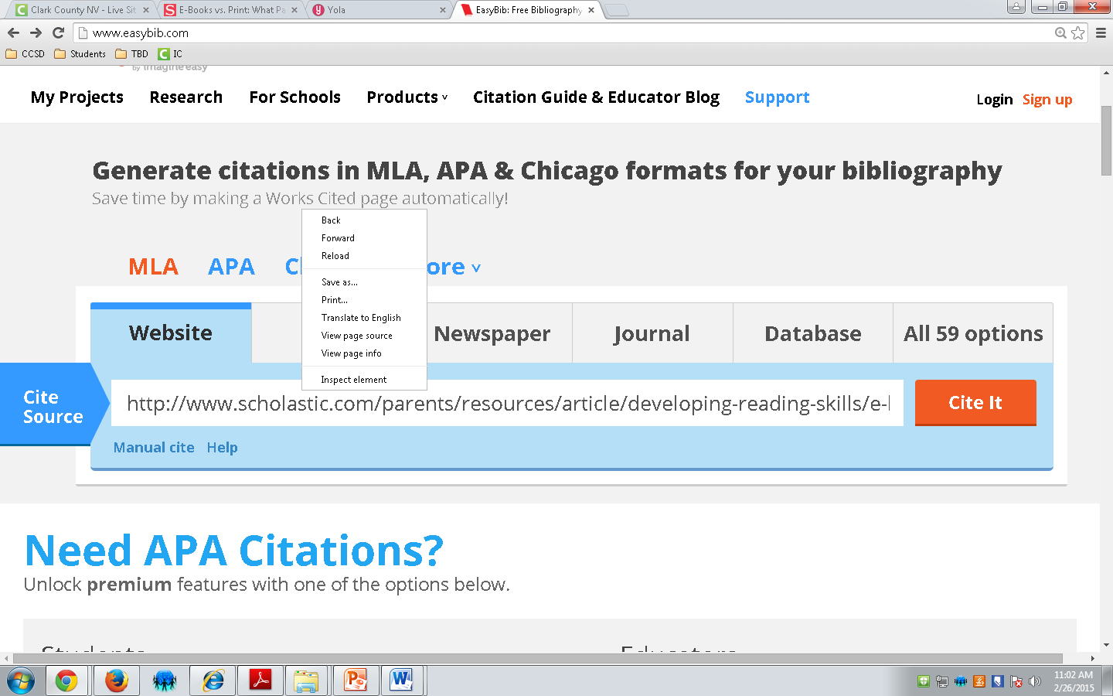
Go to www.easybib.com and copy and paste your website address into the cite source field.

Slide 15
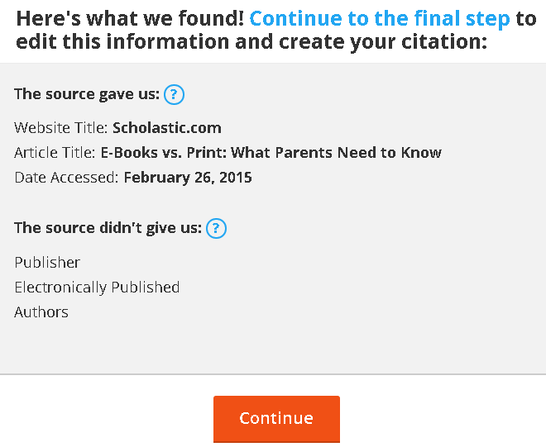
Check to see what source information EASYBIB could NOT find.
Then click continue.

Slide 16
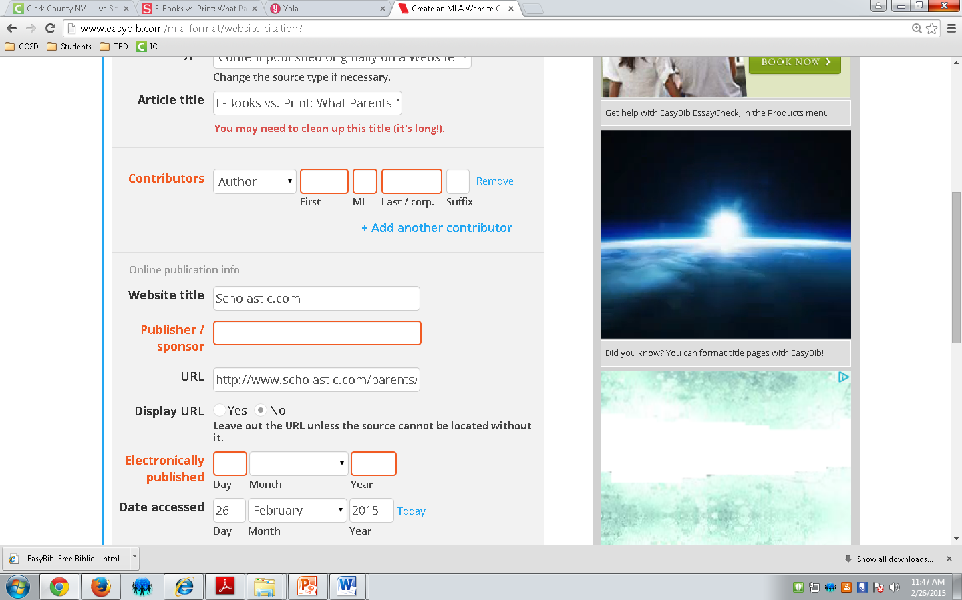
Look at the website and see if you can locate information EASYBIB could not find and then type it in. If you cannot find the information, leave it blank.

Slide 17
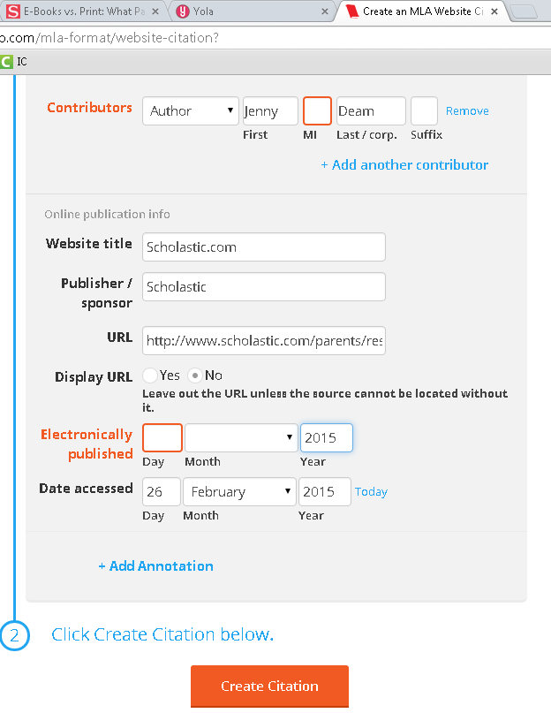

Slide 18
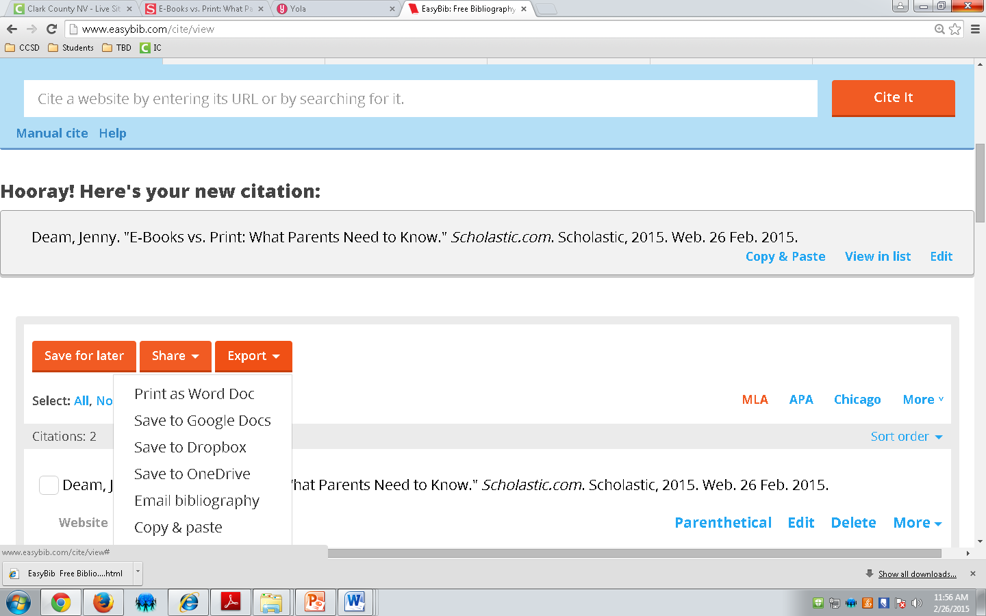
Here’s your MLA citation!
Click “Export”, then click “Print as Word Doc”.

Slide 19
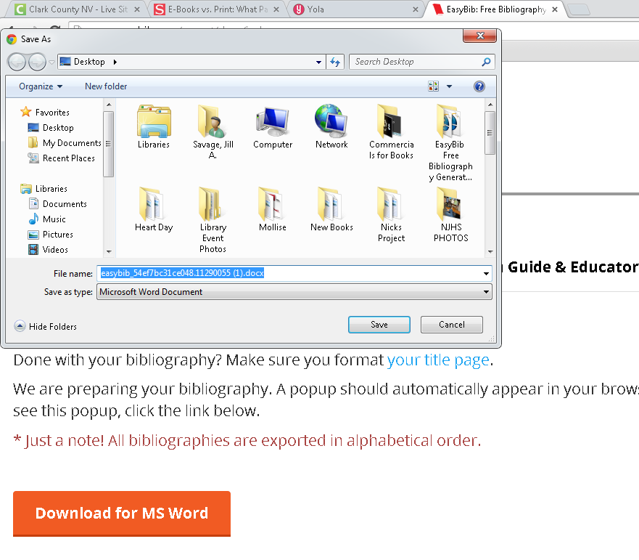

Slide 20
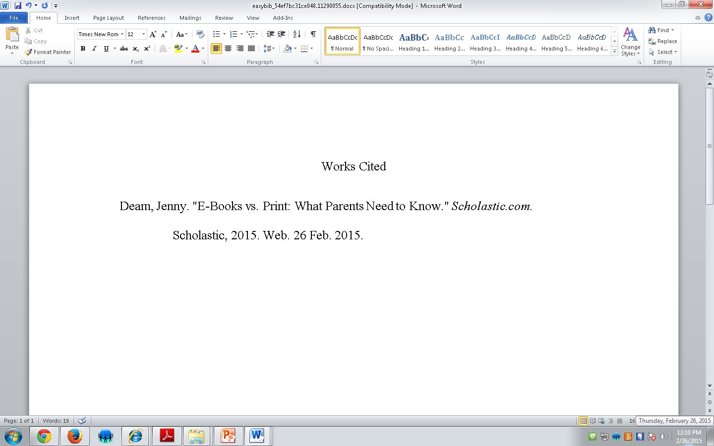
Here’s your MLA citation document!

